Slide 1
CAP7001:
Data Communication and Networking
Unit-II
Transmission Media

Slide 2
Transmission Media
Channel carrying information signals.
Moves bits across LANs.
Physical path transmitter to receiver.
Copper uses electrical signals.
Fiber uses light pulses.
Layer 1 physical component.

Slide 3
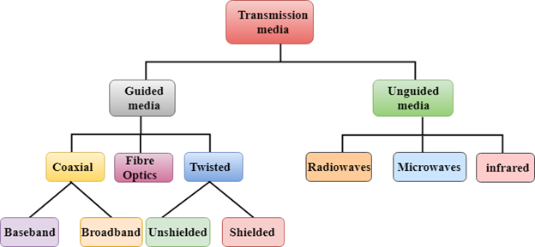
Classification of Transmission Media
Guided (wired) transmission media.
Unguided (wireless) transmission media.

Slide 4
Factors Affecting Media
Bandwidth sets data rate.
Transmission impairment degrades quality.
Impairments: attenuation, distortion, noise.
Interference: unwanted signal addition.
Medium, signal characteristics matter.

Slide 5
Guided Media
Physical bounded transmission paths.
Types: Twisted Pair cables.
Coaxial cable: baseband, broadband.
Fiber optic: single, multimode.

Slide 6
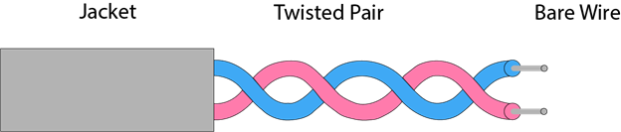
Twisted Pair
Two insulated copper wires.
Twisted spiral noise reduction.
Cheap, lightweight, easy install.
Frequency range 0–3.5 kHz.
More twists reduce interference.

Slide 7
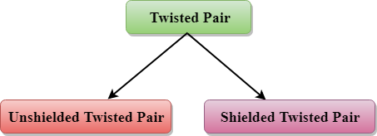
Types of Twisted Pair

Slide 8
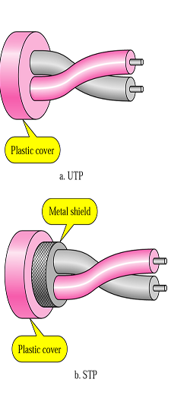
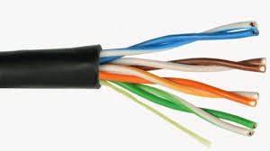
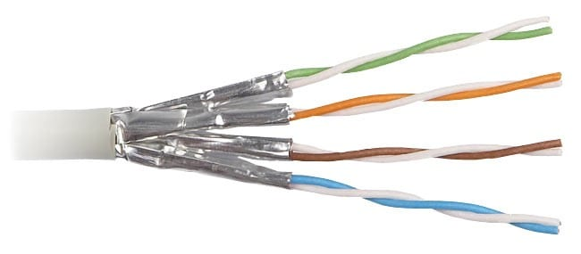

Slide 9
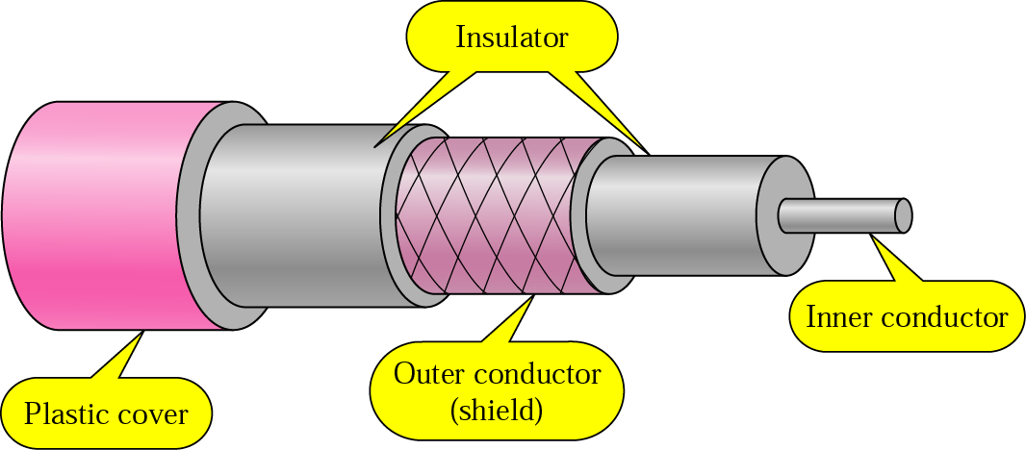
Coaxial Cable
Two parallel conductors coaxial.
Higher frequency than twisted.
Inner copper, outer mesh.
Dielectric separates conductors centrally.
Mesh shields against EMI (Electromagnetic interference)

Slide 10
Coaxial: Baseband vs Broadband
Baseband: single high-speed signal.
Broadband: multiple signals simultaneously.
Application-specific selection required.
Different equipment, modulation schemes.

Slide 11
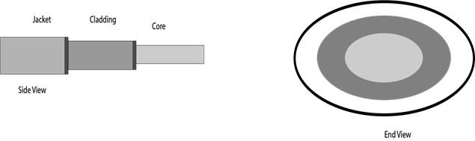
Fiber Optics Cable
Transmits using light signals.
Fibers coated with protective plastics.
Immune to electromagnetic interference.
Faster than copper wiring.
Supports high data rates.

Slide 12

Fiber: Core/Cladding/Jacket
Core: light transmission region.
Larger core transmits more light.
Cladding lowers refractive index.
Enables internal total reflection.
Jacket protects strength, shock.

Slide 13
THANK YOU

